Slide 1
Lab. 15
Logic Design Lab.
Spring 2014
Prof. Naehyuck Chang
(naehyuck@snu.ac.kr)
TA. Taeyoung Kim
(tykim@iris.snu.ac.kr)
TA. Duseok Kang
(kangds0829@iris.snu.ac.kr)

Slide 2




Example

Slide 3
Example
CPLD
Status
Score
Start
Reset

Slide 4
Example
CPLD
Status
Score
Start
Reset

Slide 5
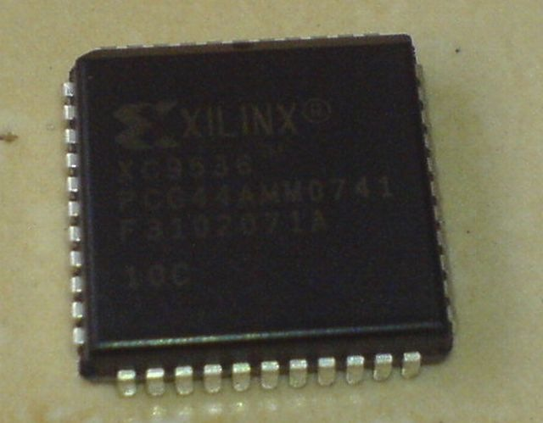
CPLD (Complex Programmable Logic Device)
CPLD (Xilinx XC9536)
Xilinx XC9536XL
5ns pin-to-pin logic delays
System frequency up to 178MHz
36 macro cells with 800 usable gates
Optimized for high-performance 3.3V systems
5V tolerant I/O pins accept 5V, 3.3V, and 2.5V signals
3.3V or 2.5V output capability

Slide 6
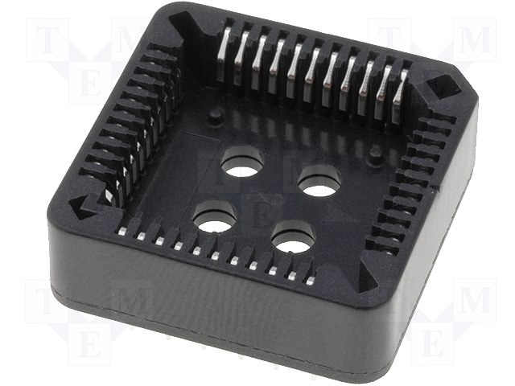
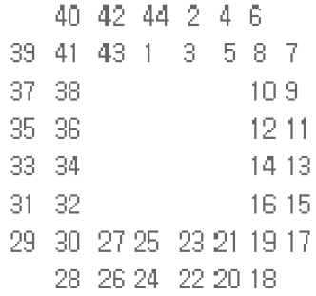
CPLD (Complex Programmable Logic Device)
PLCC44 Socket Image & Pin Assignment (Bottom view)
You can insert CPLD to your circuit with PLCC44 socket.
There are 44 pins at 9536 CPLD and PLCC44 socket.

Slide 7
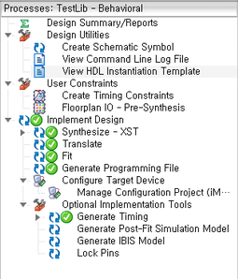
CPLD (Complex Programmable Logic Device)
Implement Design
Simulation
Floorplan IO – Pre-Synthesis
- Modify UCF file
Manage Configuration Project
Open .jed file
Erase
Program

Slide 8
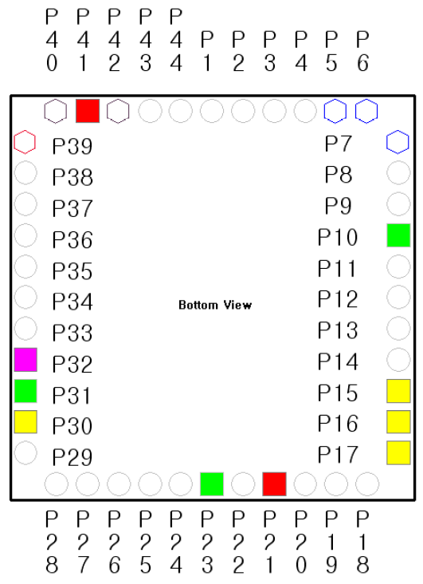
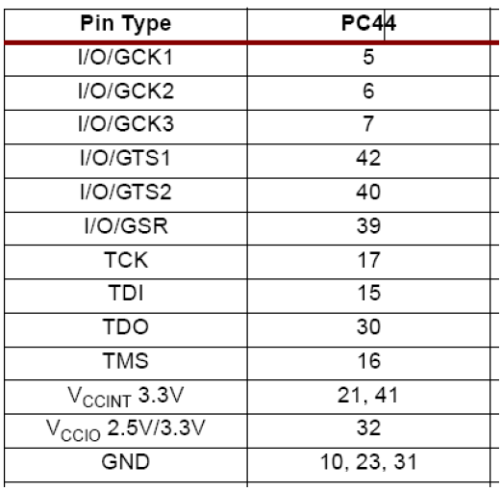
CPLD (Complex Programmable Logic Device)
9536 Pin Assignment
There are 3 VCCs and 3 GNDs.
TCK, TDI, TDO, TMS are used for reprogramming circuit to 9536.
You can use PIN5 as global clock.

Slide 9
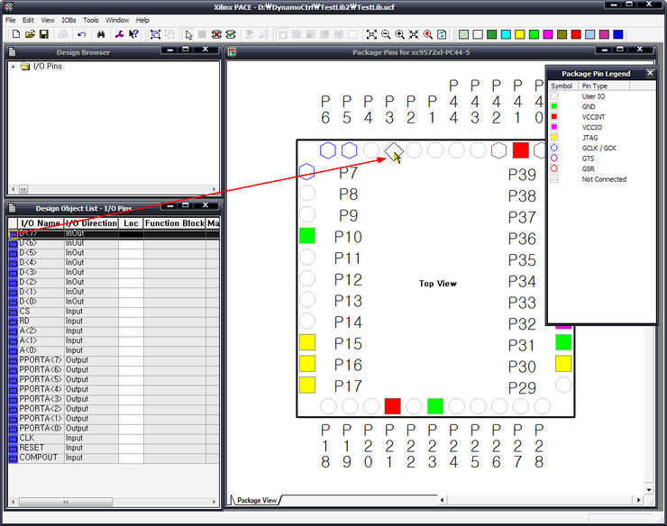
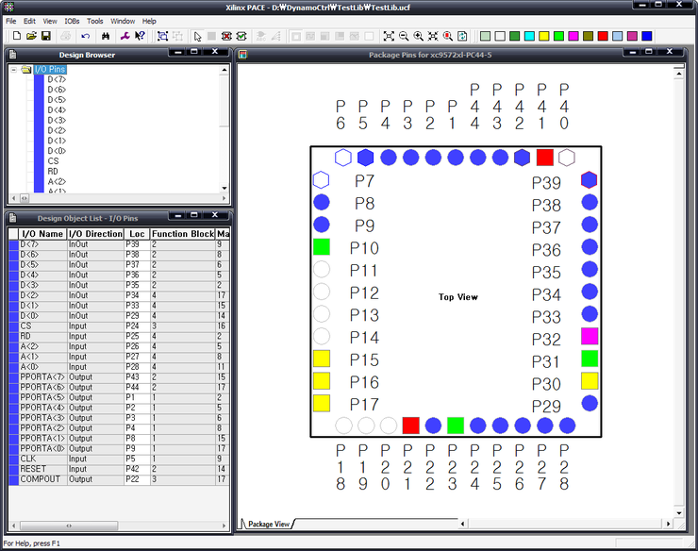
CPLD (Complex Programmable Logic Device)

Slide 10
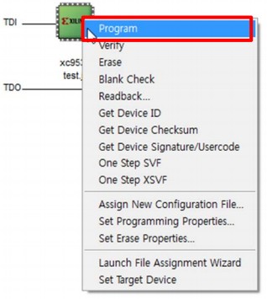
CPLD (Complex Programmable Logic Device)

Slide 11
Practice
Implement the “2:4 Decoder” on an universal board
Use CPLD
Input : 2 switches
Output : 4 LEDs
Write VHDL or Verilog code for the decoder
Simulate and verify

